Slide 1
AI & Data Science
Then Now and the Future

Slide 2
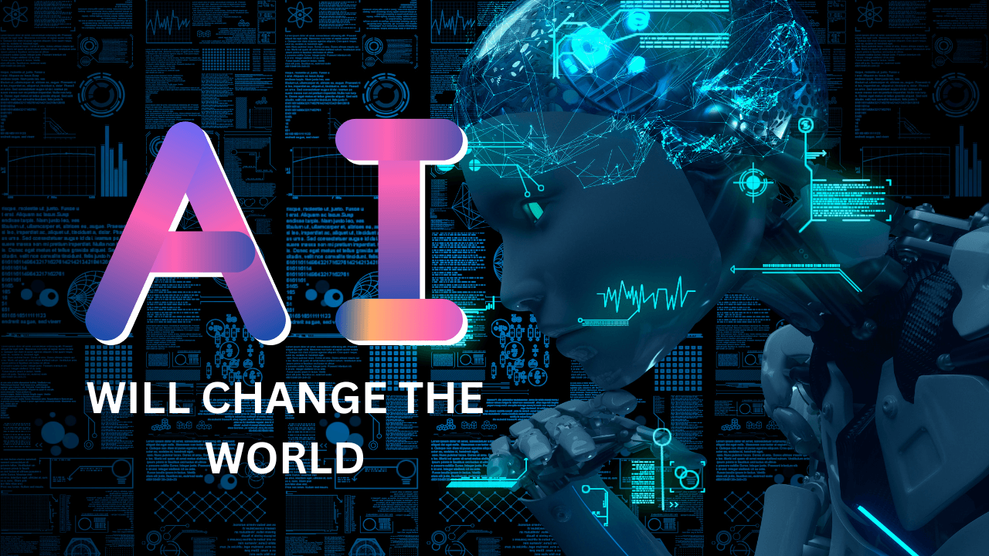

Slide 3
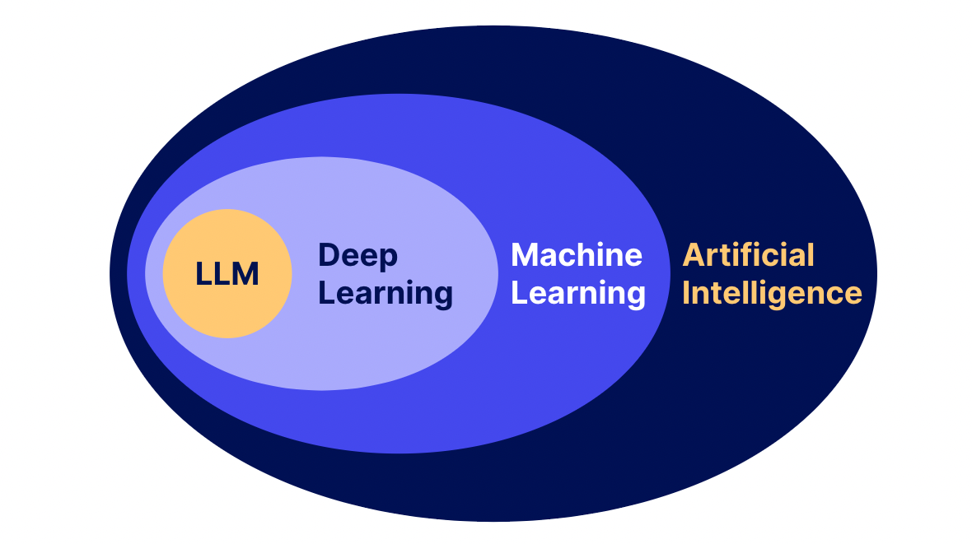
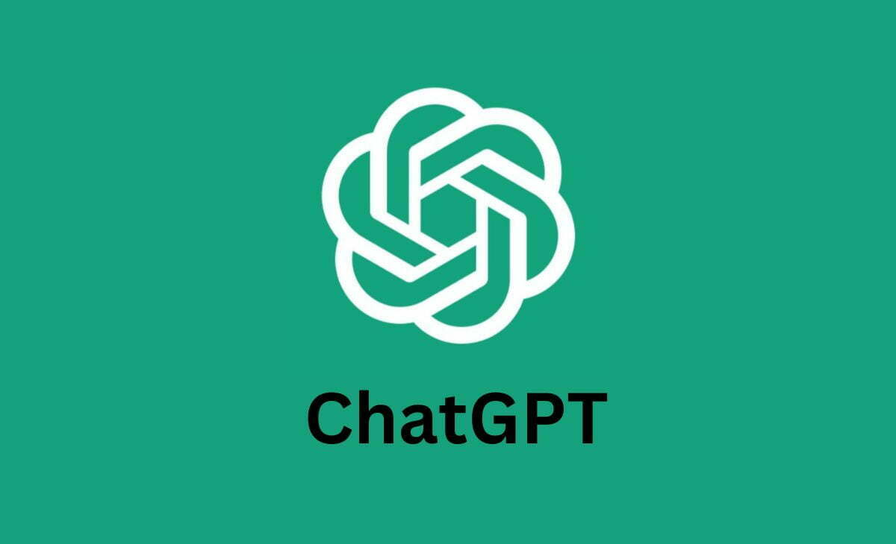
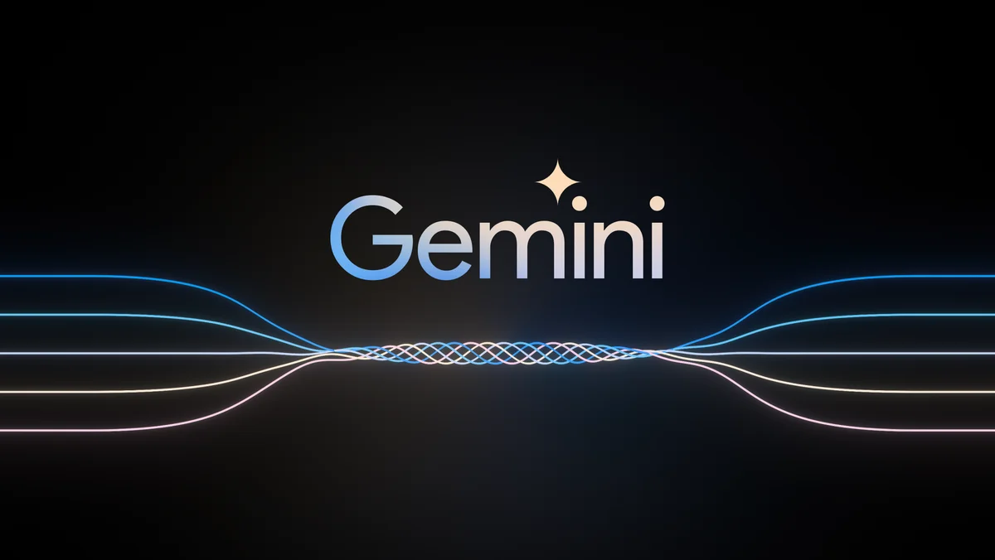
How ?

Slide 4
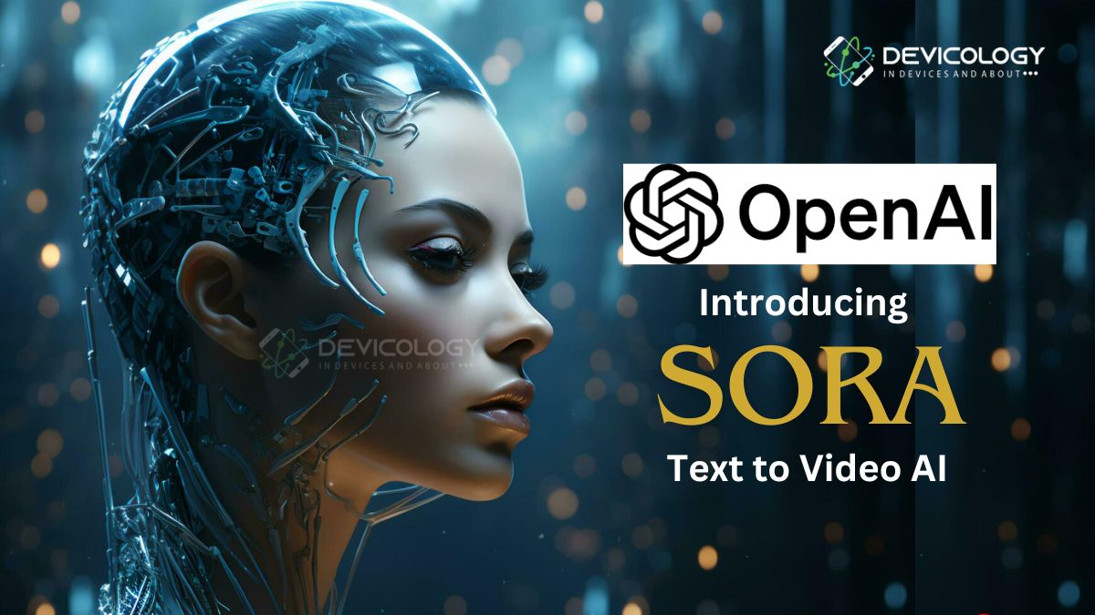
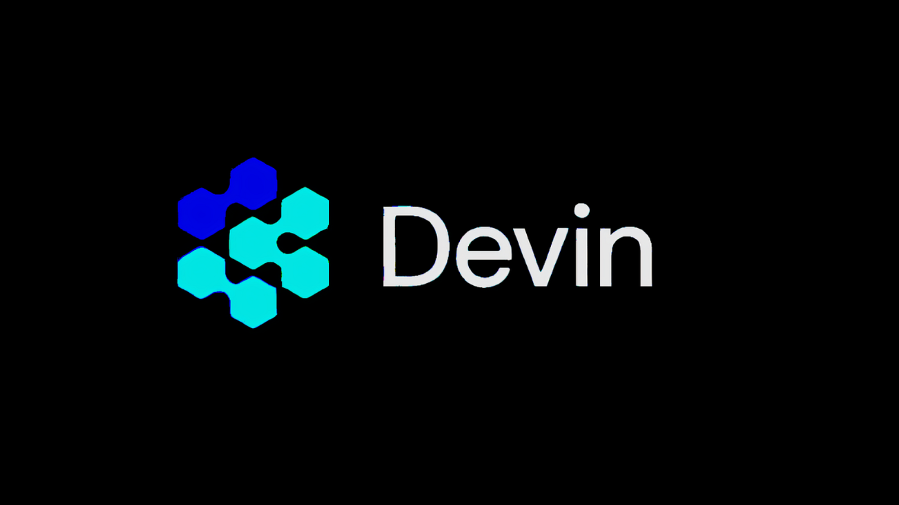
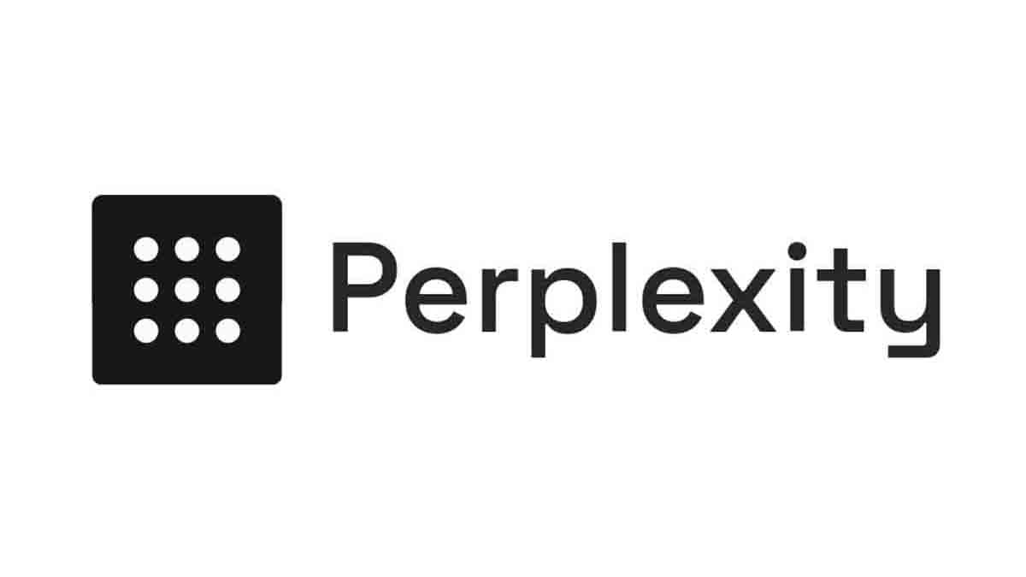
How ?

Slide 5

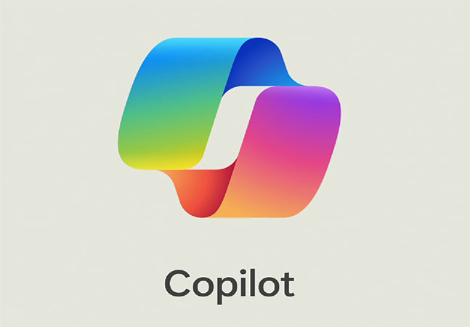
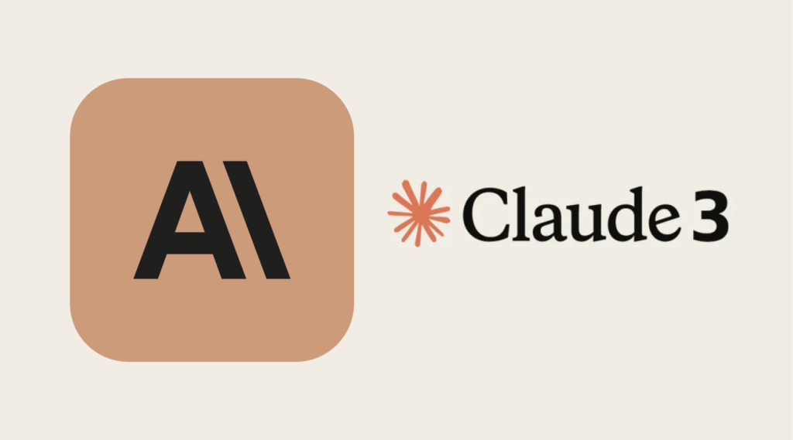
How ?

Slide 6
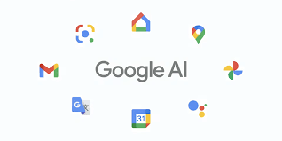
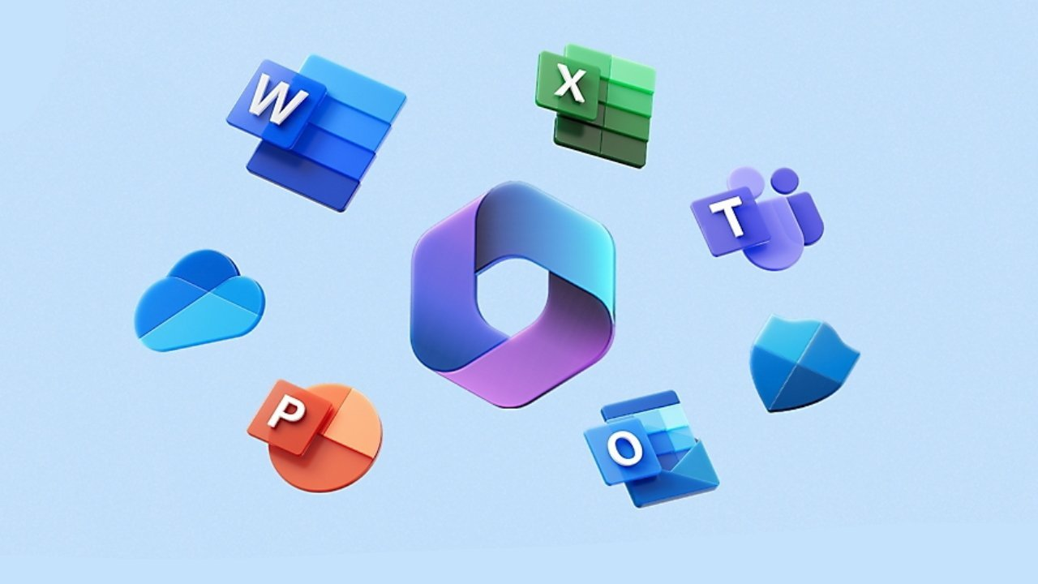
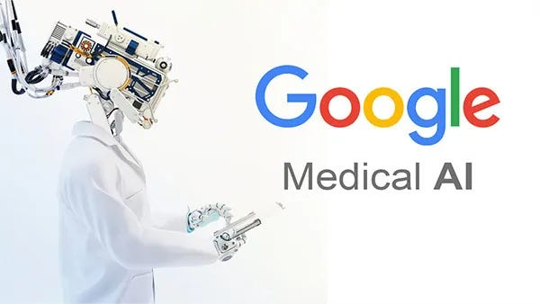
How ?

Slide 7
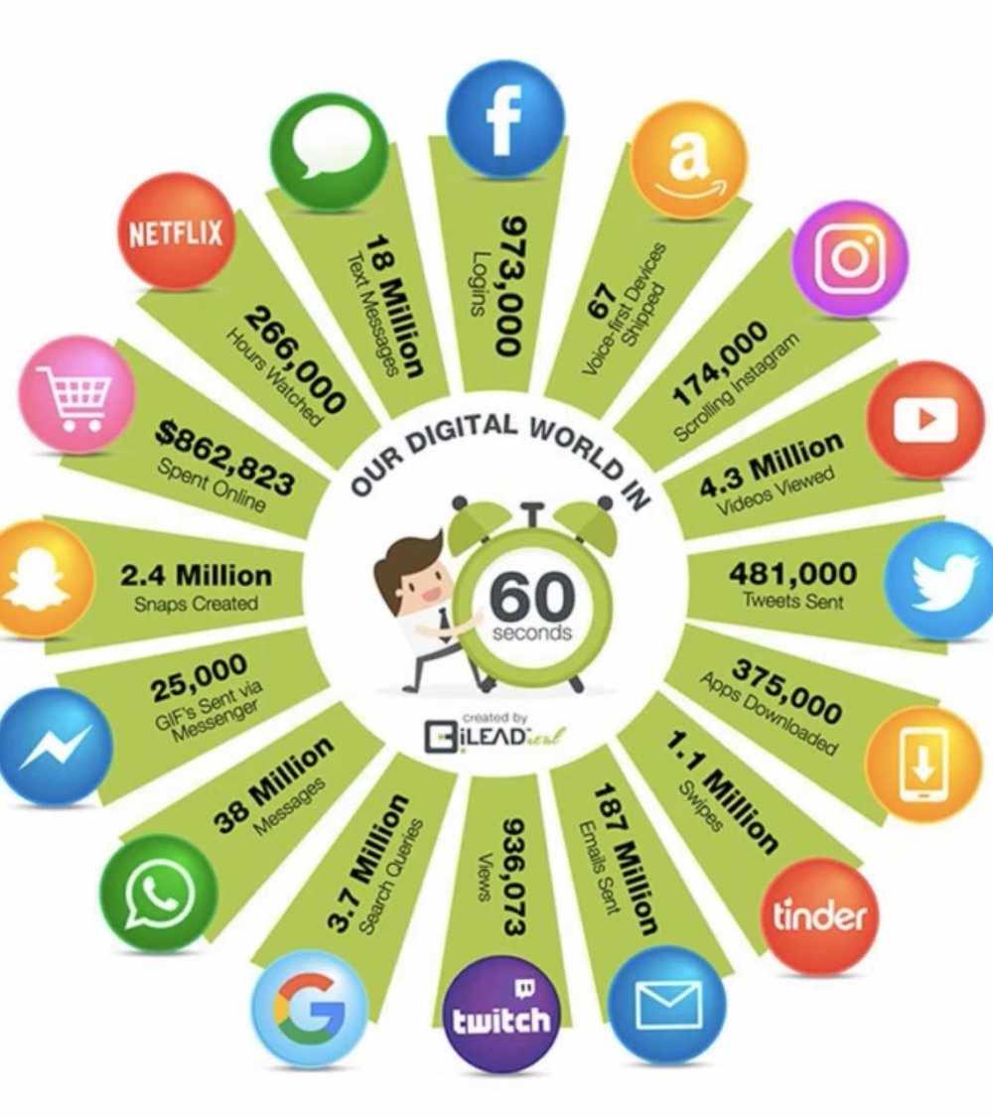
Data Data Data!!!.....

Slide 8
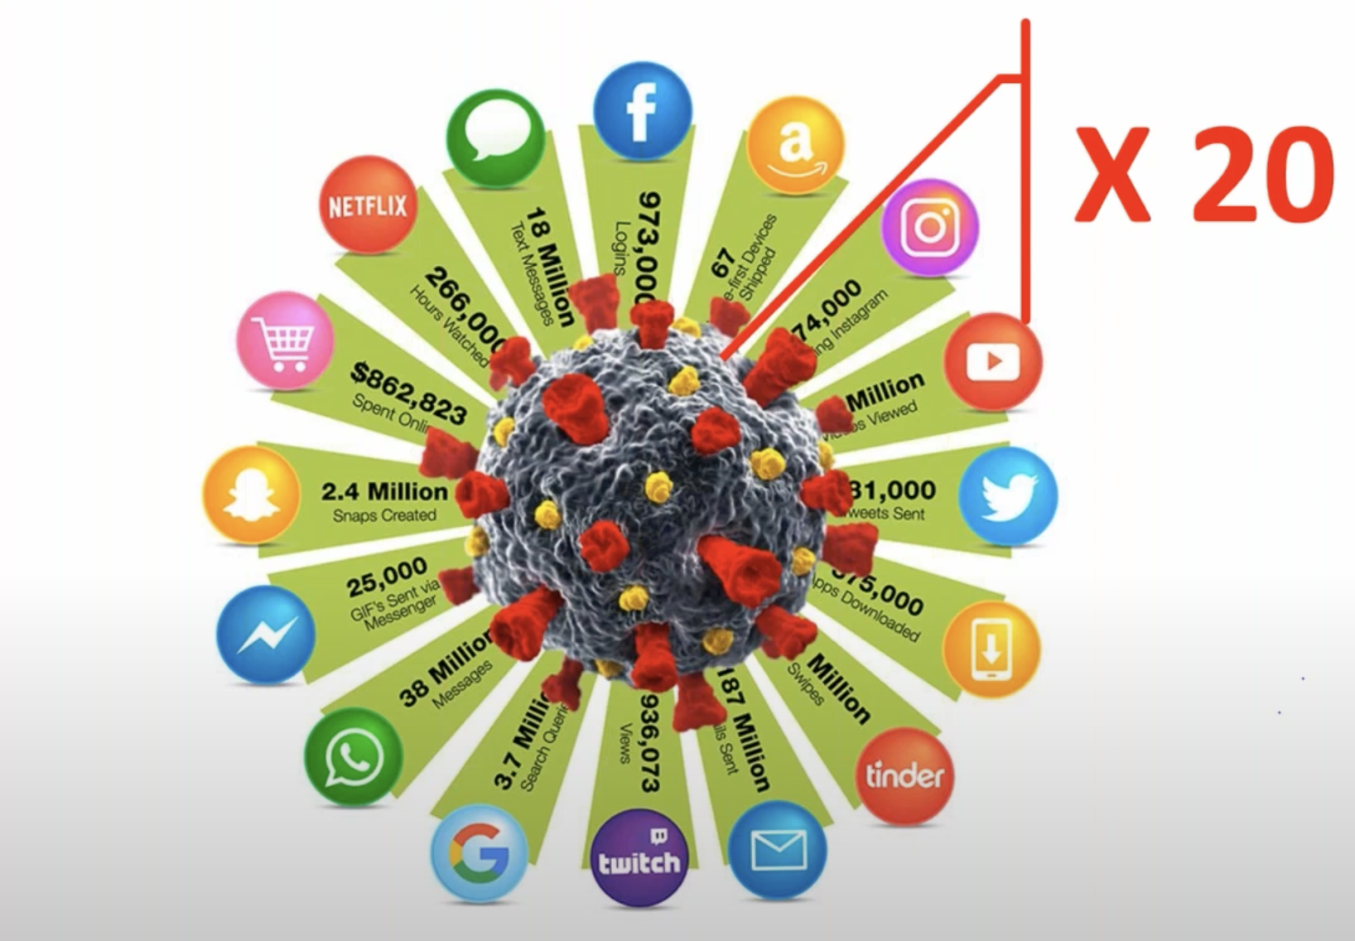
Data Data Data!!!.....

Slide 9
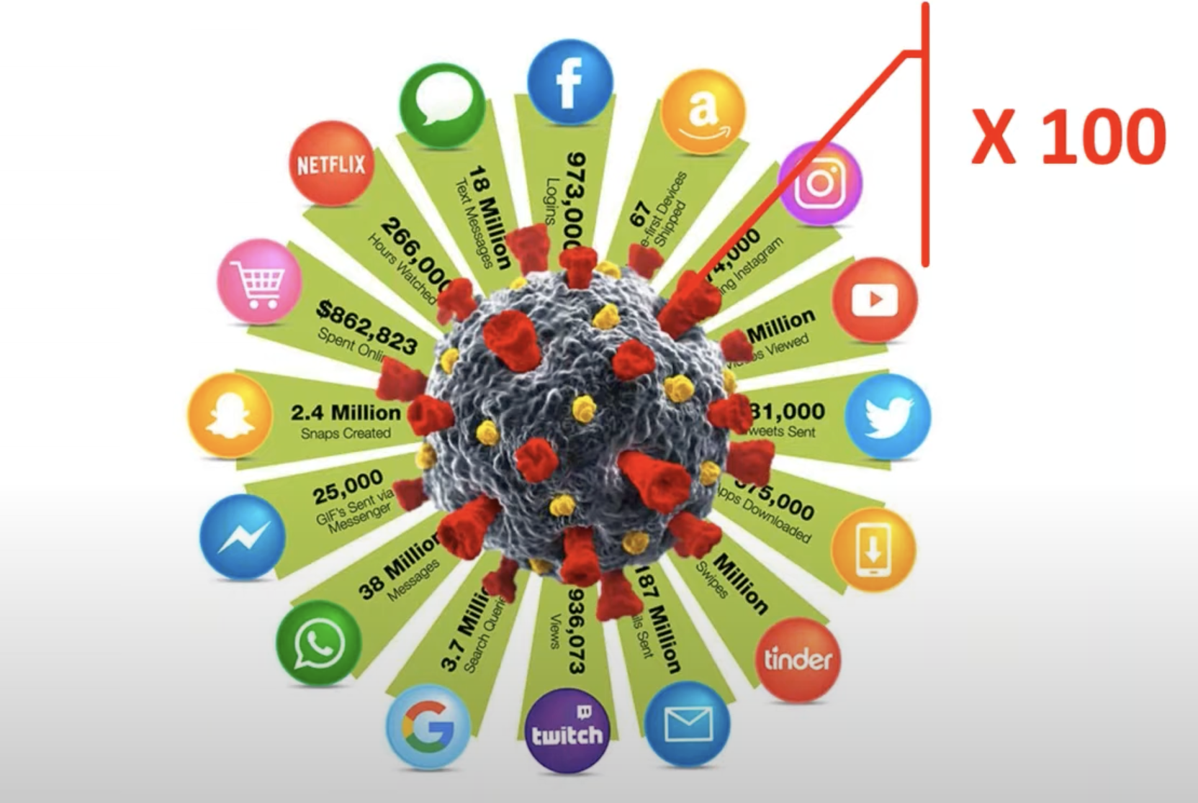
Data Data Data!!!.....

Slide 10
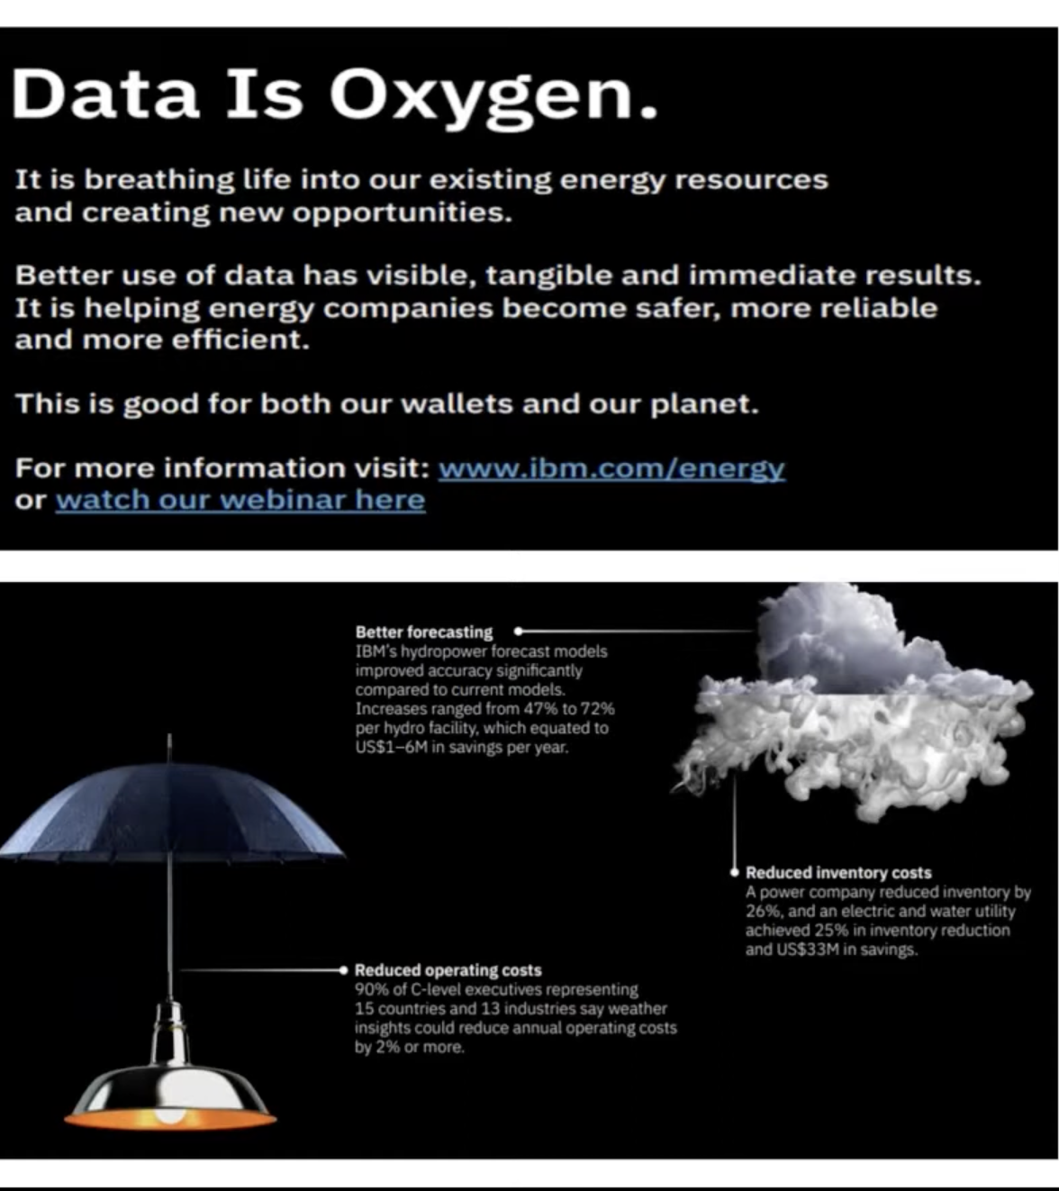
Data Data Data!!!.....

Slide 11
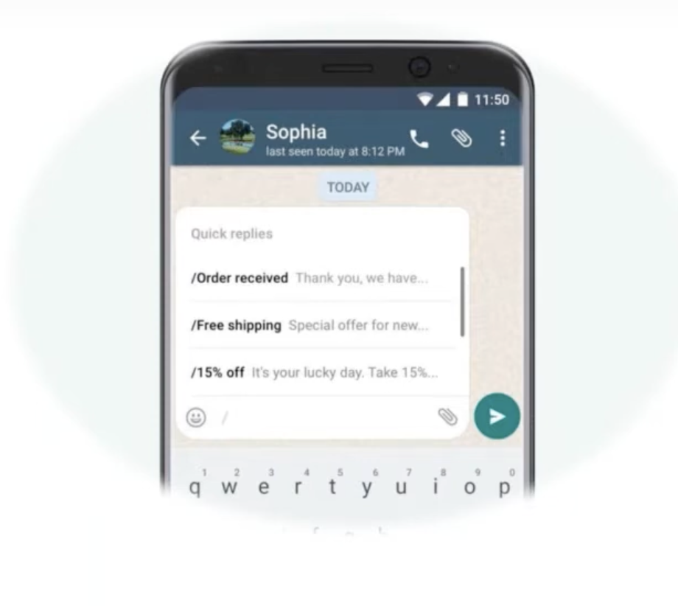
Examples

Slide 12
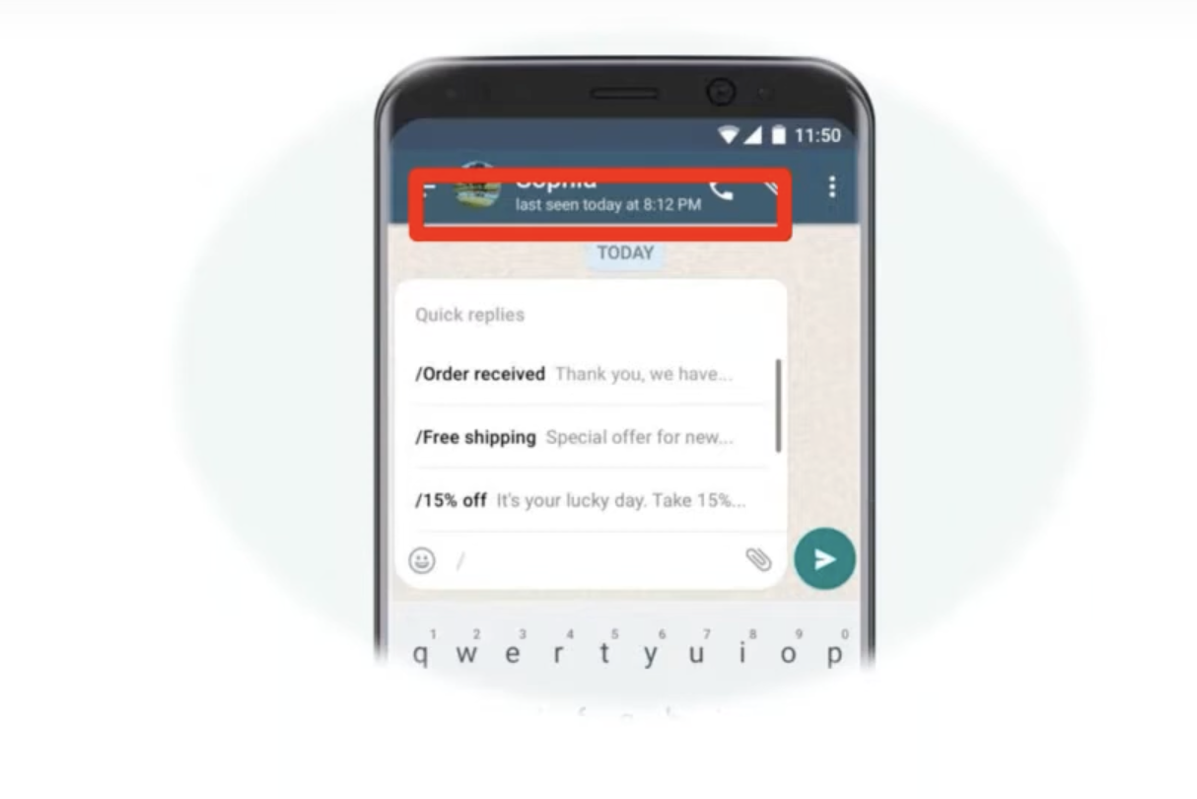
Examples

Slide 13
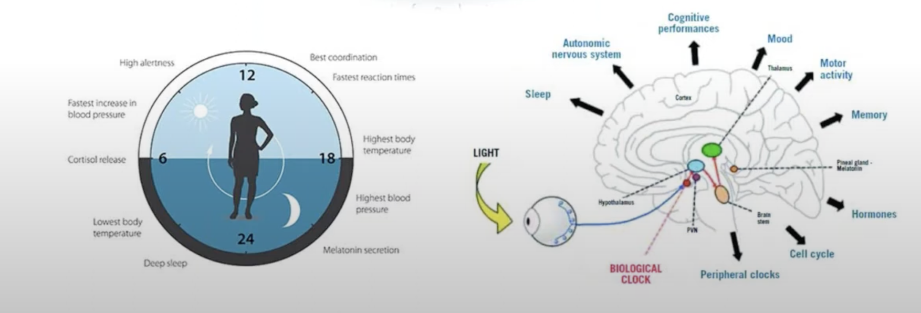
Examples

Slide 14
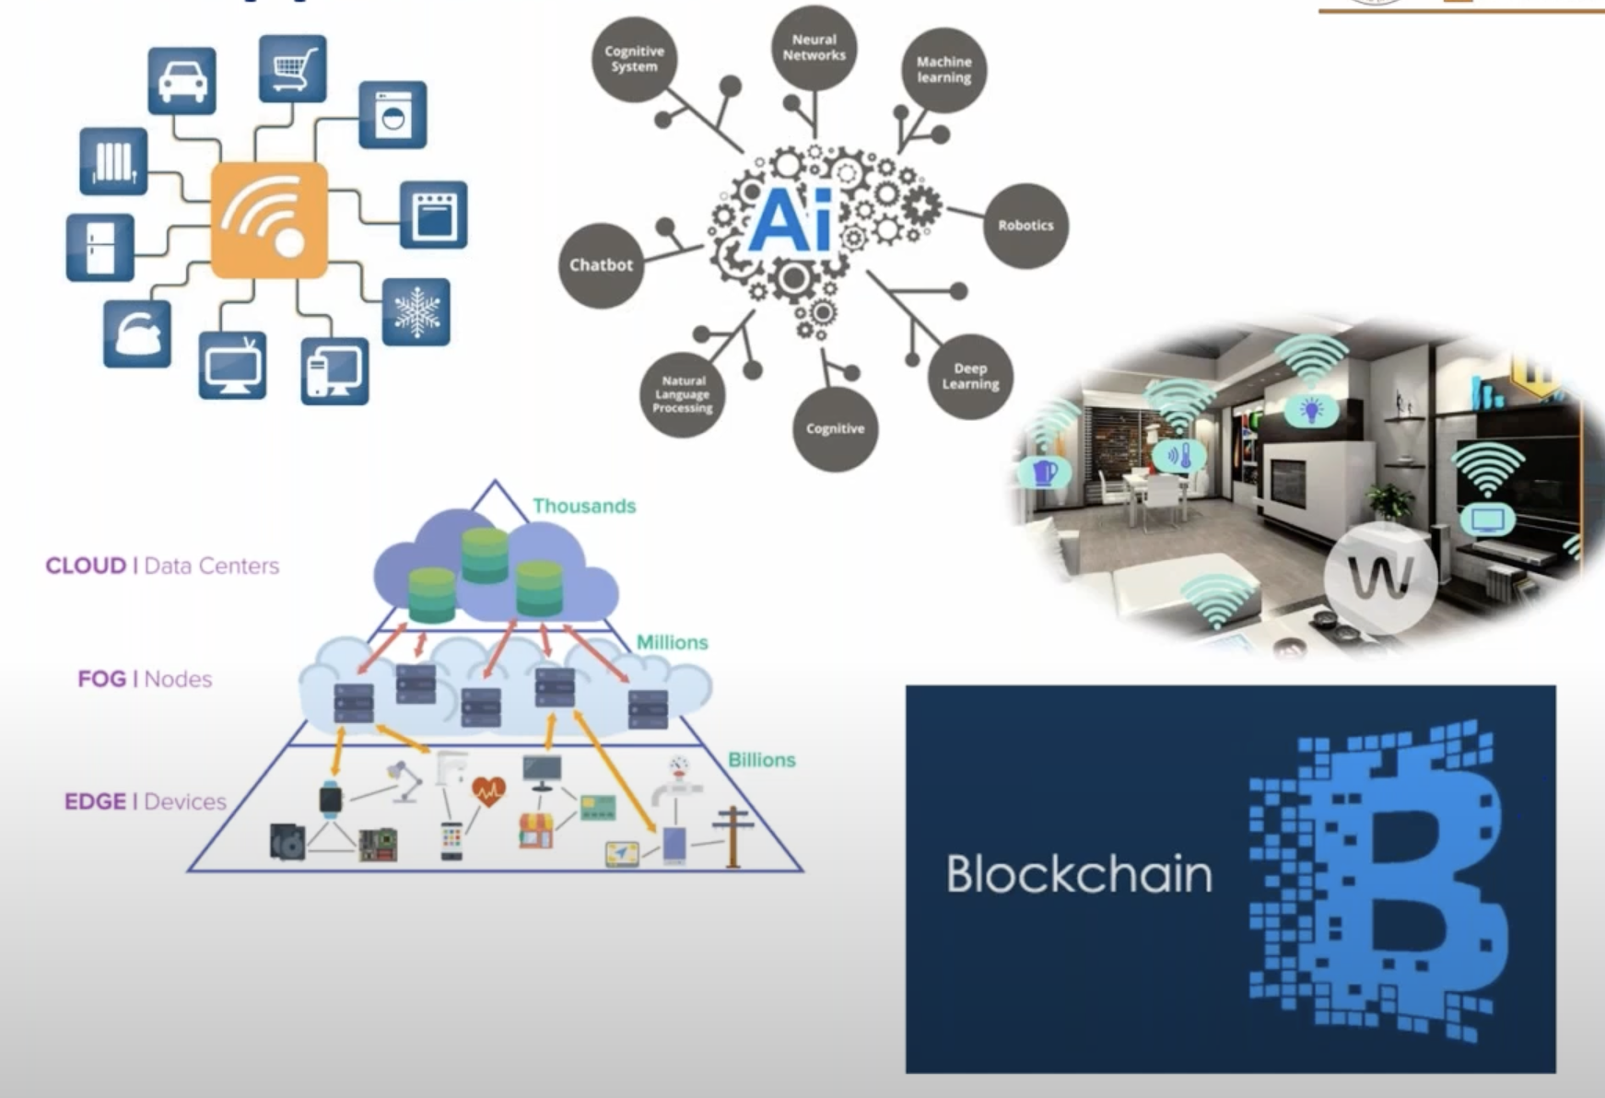
The Opportunity

Slide 15
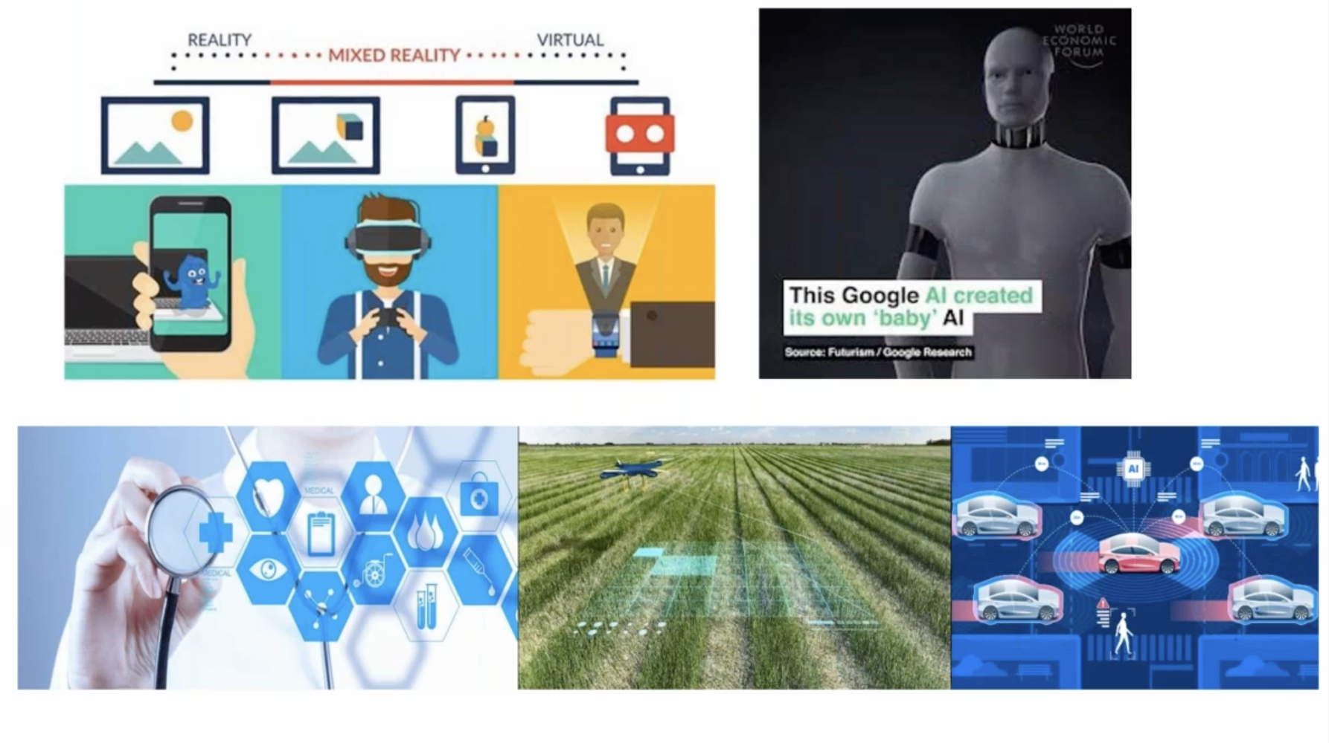
Future and Tomorrows

Slide 16
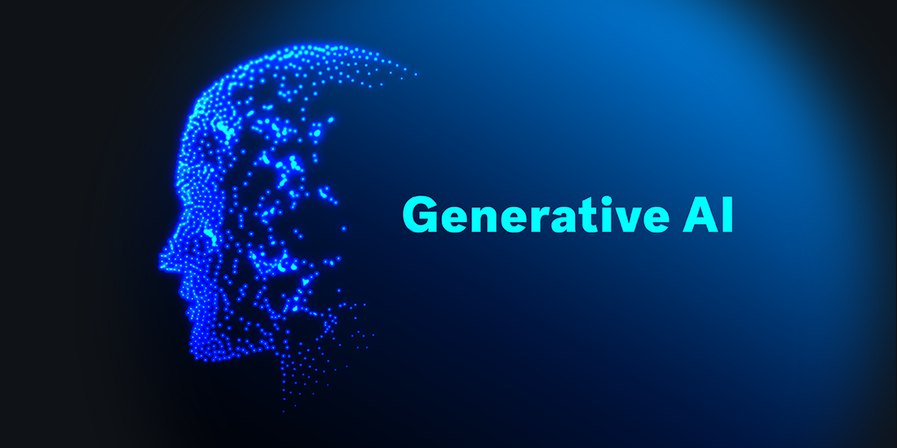
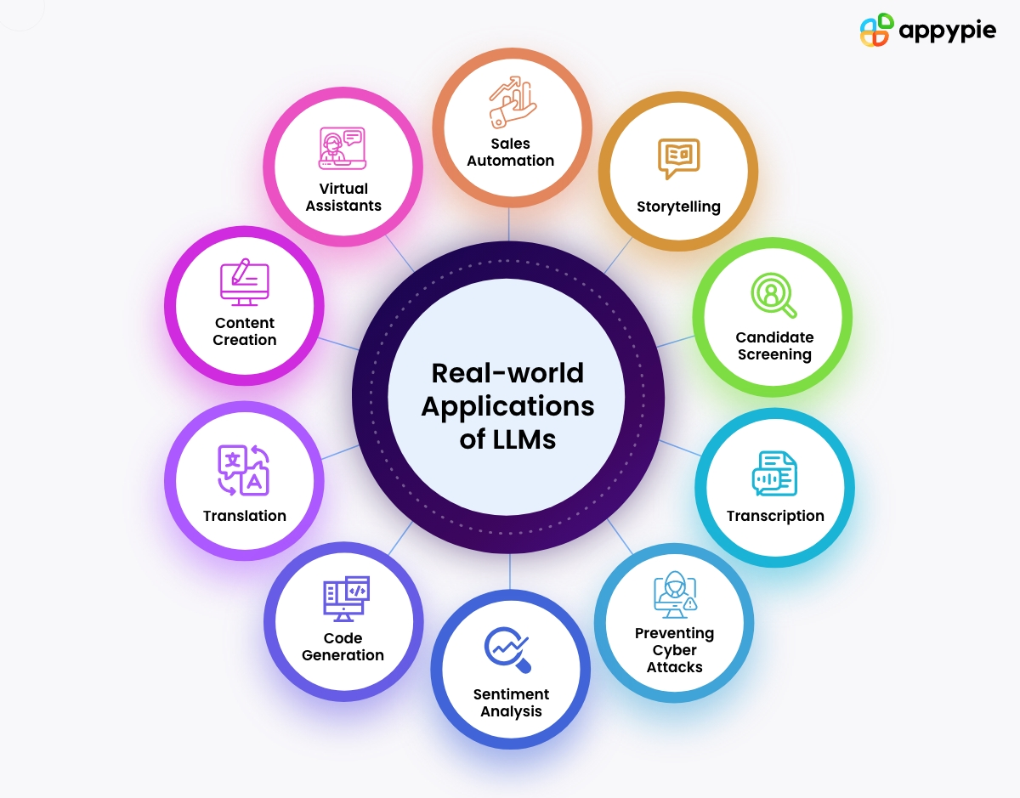
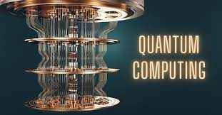
Future and Tomorrows

Slide 17
Future and Tomorrows

Slide 18
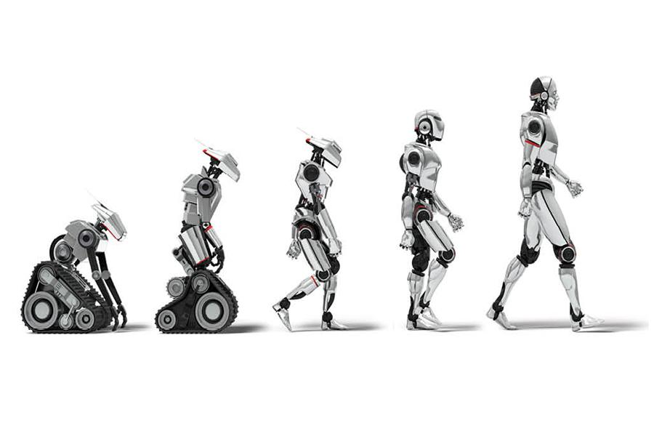
Cut Above
Learn by Doing in Public
Projects are the Keys
Explore Trans Disciplinary Domains
Participations in Internationals and National Level Events
Building Strong Digital Presence
Co-Create the Magic

Slide 19
COMPLETE ROADMAP OF DATA SCIENCE

Slide 20
Python Learning Path
1. Introduction to Python
Setup: Install Python from the official website (python.org) and set up your development environment (e.g., using an IDE like PyCharm, VSCode, or Jupyter Notebook).
Basic Syntax:
Hello World: Write your first Python program
2. Basic Programming Concepts
Variables and Data Types:
Keywords
identifier
Operators:

Slide 21
Control Flow: Master if-else statements, loops (for and while), and control flow tools like break and continue.
3. Data Structures
Lists
Tuples
Strings
Dictionaries
Sets

Slide 22
4. Functions and Modules
Functions
Lambda Functions
Hiegher order function
5. Error Handling
Exceptions: Try-except blocks, raising exceptions, and handling multiple exceptions.

Slide 23
9. Python Memory Management
Memory Allocation
Garbage Collection
Reference Counting
Memory Leaks:

Slide 24
Applied python
File Handling
Reading and Writing Files: Open, read, write, and close files.
Working with Different File Formats: CSV, JSON, etc.
2.Data Analysis:
Libraries: NumPy, Pandas, Matplotlib, Seaborn
Concepts: Data manipulation, statistical analysis, data visualization.
Projects: Data cleaning, exploratory data analysis, visualizing trends.

Slide 25
Table of content : Machine learning & Deep Learning
1. Introduction to Machine Learning
What is Machine Learning?
Types of Machine Learning: Supervised, Unsupervised, Reinforcement
Key Applications
2. Basic Mathematics for Machine Learning
Linear Algebra
Probability and Statistics
Calculus

Slide 26
4. Supervised Learning
Regression: Linear, Polynomial
Classification: Logistic Regression, k-NN, SVM, Decision Trees, Random Forests
Model Evaluation: Accuracy, Precision, Recall, F1 Score
5. Unsupervised Learning
Clustering: k-Means, Hierarchical
Dimensionality Reduction: PCA

Slide 27
6.Neural Networks and Deep Learning
Introduction to Neural Networks
Convolutional Neural Networks (CNN)
Recurrent Neural Networks (RNN)
7. Model Evaluation and Tuning
Cross-Validation
Hyperparameter Tuning
Overfitting and Underfitting

Slide 28
8. Reinforcement Learning
Basic Concepts
Q-Learning
9. Practical Applications and Projects
Case Studies: Predictive Analytics, Image Recognition, recommendation
Building and Deploying Models

Slide 29
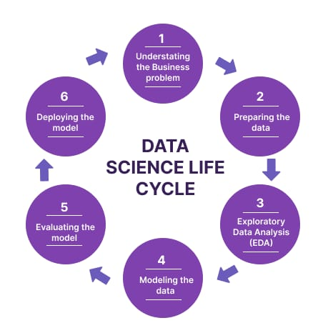

Slide 30
Introduction to Python
Who can learn Python
Prerequisite To learn Python
Introduction to Python programming
Programmer friendly -HL
Machine Friendly -LL
Usage
Desktop application
Gmail Application Any Web Application
IOT
Data Science
Etc
General Purpose High level Programming Language

Slide 31
History Of Python
Developed by Guido Van Rossum in 1989 while working at National Reachers Institute at Netherland
In 1991 it made public
Java

Slide 32
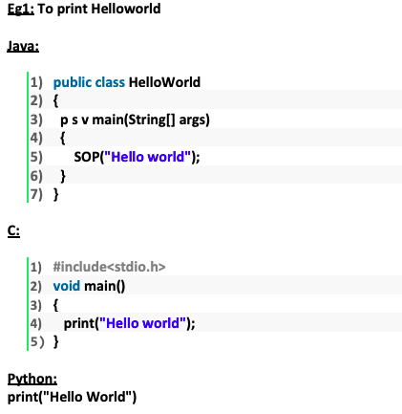

Slide 33
Where we can use Python
We can use everywhere.
The most common important application areas are
1) For developing Desktop Applications
2) For developing web Applications
3) For developing database Applications
4) For Network Programming
5) For developing games
6) For Data Analysis Applications
7) For Machine Learning
8) For developing Artificial Intelligence Applications
9) For IoT

Slide 34
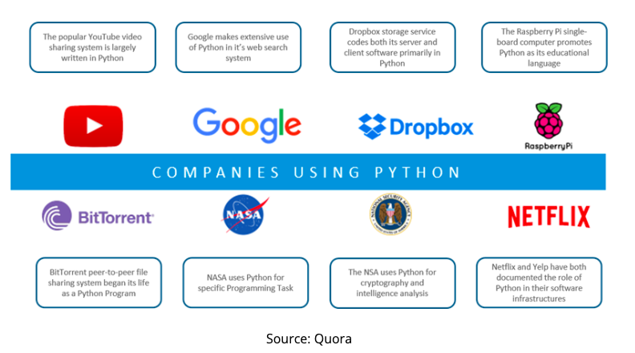

Slide 35
Large Tech companies using python :
1. Google
Use Cases: Web development, data analysis, artificial intelligence, machine learning, and system administration.
2. Facebook
Use Cases: Image processing (Instagram, which is owned by Facebook, heavily uses Python), data analysis, machine learning, and operational automation
3. Netflix
Use Cases: Data analytics, recommendation algorithms, automation scripts, and machine learning.

Slide 36
4. Spotify
Use Cases: Recommendation systems, data analytics, and backend services.
5. NASA
Use Cases: Data processing, scientific computations, and automation.
6. Dropbox
Use Cases: Backend development, client applications, and API integration.

Slide 37
7. Quora,
Use case: a popular question-and-answer website, is another example of a company who uses Python for its simplicity and speed of development.
8. Instagram
Instagram is a photo and video-sharing social media or networking platform possessed by Facebook, Inc. It is one of the most renowned companies who use Python language in association with Django and in recent times,
The prime reason for Instagram to opt for Python is its efficiency, simplicity, and practicality.

Slide 38
9. YOU TUBE
YOU TUBE a Google subsidiary, was built primarily in Python. The world’s largest video streaming site, which has been distracting us from existential sorrow with funny videos since 2005, is a prime real-world example of Python in web development.
10 .Yahoo!
Google’s main competitor, uses the Python programming language in various projects. Yahoo! Maps makes use of the language and its frameworks. Although Yahoo Maps is losing ground to competing map service providers, it still has several valuable features. Apart from that, Python is used in several Yahoo interface designs. The language has provided platform search capabilities akin to Google.

Slide 39
Features of Python
Simplicity and Ease of Learning
English-like syntax
Few keywords and concise code
Readability and simplicity
Reduced development time and cost
Freeware and Open Source
Free to use without any license
Source code is open for customization
Examples: Jython for Java applications
High-Level Programming Language
Programmer-friendly language
Abstraction from low-level activities like memory management
Platform Independence
Python programs run on any platform without rewriting
PVM converts code into machine-understandable form.

Slide 40
Portability
Python programs are portable across platforms
Consistent results on any platform
Dynamically Typed
Automatic type allocation based on assigned values
Dynamic typing provides flexibility
Contrasted with statically typed languages like Java and C
Support for Both Procedure Oriented and Object Oriented Programming
Benefits of both paradigms, such as security and reusability
Interpreted
No explicit compilation required
Python interpreter handles compilation
Syntax errors are raised during compilation
PVM executes the compiled code
Extensibility
Integration of other language programs with Python
Use existing legacy code
Improve application performance
Extensive Library
Rich inbuilt library in Python
Access to pre-implemented functionality
Saves effort in implementing common tasks

Slide 41
Limitations of Python
1) Performance wise not up to the mark because it is interpreted language.
2) Not using for mobile Applications.

Slide 42
Flavors of Python
1) CPython:
It is the standard flavor of Python. It can be used to work with C lanugage Applications.
2) Jython OR JPython:
It is for Java Applications. It can run on JVM
3) IronPython:
It is for C#.Net platform
4) PyPy:
The main advantage of PyPy is performance will be improved because JIT compiler is available inside PVM.
5) RubyPython
For Ruby Platforms
6) AnacondaPython
It is specially designed for handling large volume of data processing.

Slide 43
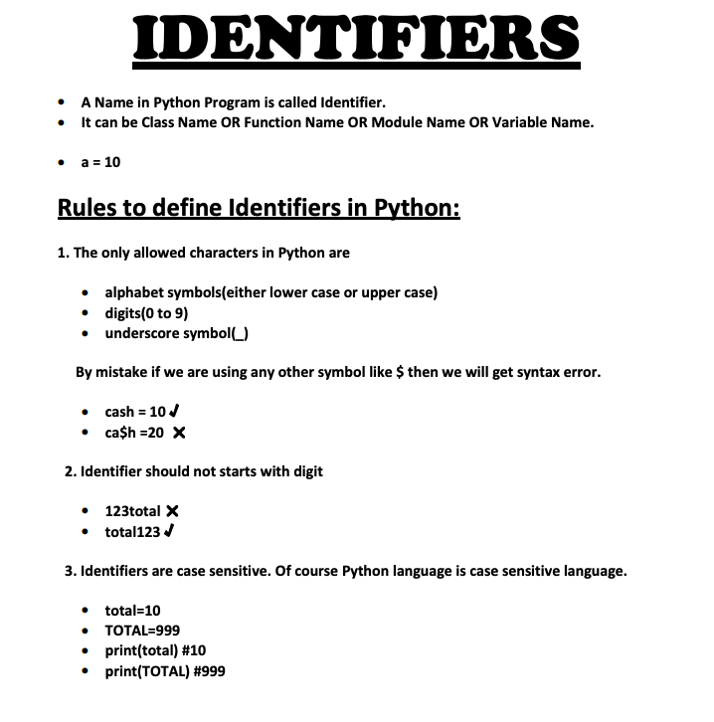

Slide 44
Identifier
1) Alphabet Symbols (Either Upper case OR Lower case)
2) If Identifier is start with Underscore (_) then it indicates it is private.
3) Identifier should not start with Digits.
4) Identifiers are case sensitive.
5) We cannot use reserved words as identifiers Eg: def = 10
6) There is no length limit for Python identifiers. But not recommended to use too lengthy identifiers.
7) Dollor ($) Symbol is not allowed in Python.

Slide 45
Keywords
In Python some words are reserved to represent some meaning or functionality. Such types of words are called keywords.
There are 36 reserved words available in Python
True, False, None
and, or ,not,is
if, elif, else
while, for, break, continue, return, in, yield
try, except, finally, raise, assert
import, from, as, class, def, pass, global, nonlocal, lambda, del, with
async,await

Slide 46
DATA TYPES
Data Type represents the type of data present inside a variable.
In Python we are not required to specify the type explicitly. Based on value provided, the type will be assigned automatically.Hence Python is dynamically Typed Language.
Python contains the following inbuilt data types
1) Int
2) Float
3) Complex
4) Bool
5) Str

Slide 47
6) Bytes
7) Bytearray
8) Range
9) List
10) Tuple
11) Set
12) Frozenset
13) Dict
14) None

